Slide 1
Text summarization
Deep learning Project

Slide 2
Problem
2.5M+
news articles published daily
The Challenge
The modern world produces an overwhelming volume of text every day. News articles, research papers, and reports are too long for people to consume fully, creating an information overload problem.
Our Goal
Build a Text Summarization system using a small Transformer model that automatically condenses long news articles into concise, accurate, and fluent summaries.
15 min
avg. time to read a full article
~80%
reading time saved with summarization

Slide 3
CNN/DailyMail Dataset
Dataset Split Distribution
Source
CNN and Daily Mail news websites. Collected by Hermann et al. (2015) and extended by See et al. (2017).
Dataset Size
~311,971 article-summary pairs (Train: 287k, Val: 13k, Test: 11k).
Train 287,113 (92%)
Validation 13,368 (4%)
Input / Output
Input: Full news article (~800 words avg)
Output: Bullet-point highlights (~55 words avg)
Why This Dataset?
Industry-standard benchmark, freely available via Hugging Face, well-documented, and ideal for Transformer training.
Test 11,490 (4%)

Slide 4
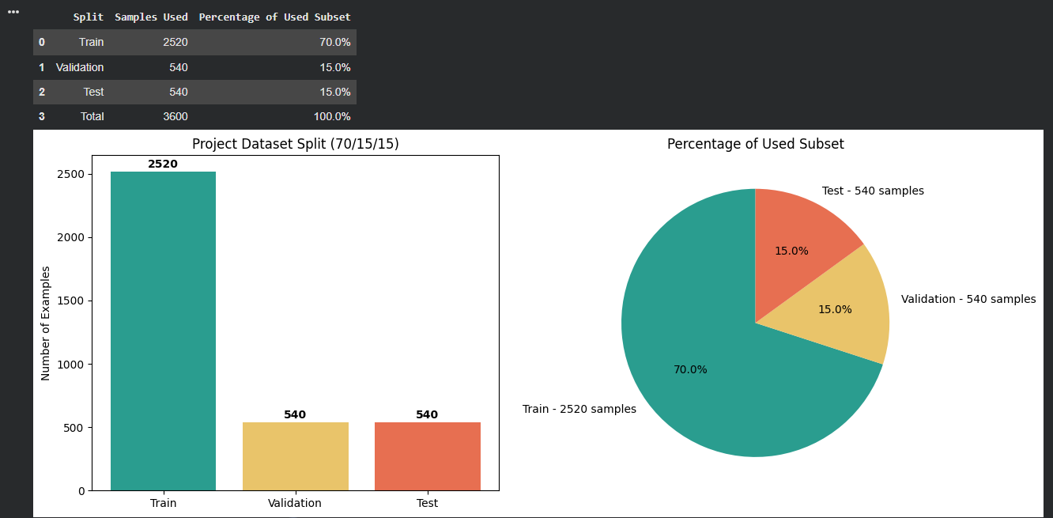
CNN/DailyMail Dataset

Slide 5
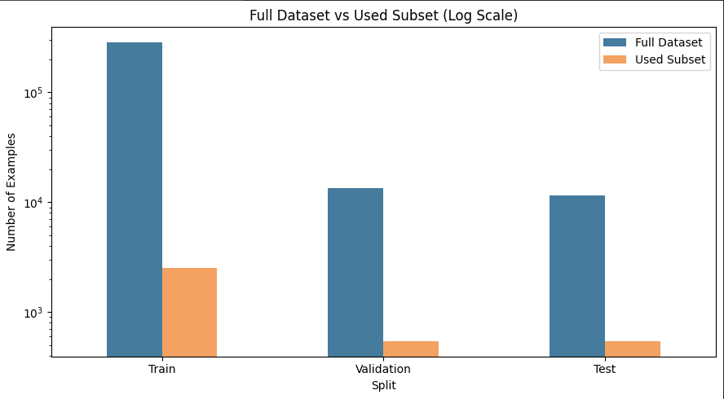
CNN/DailyMail Dataset

Slide 6
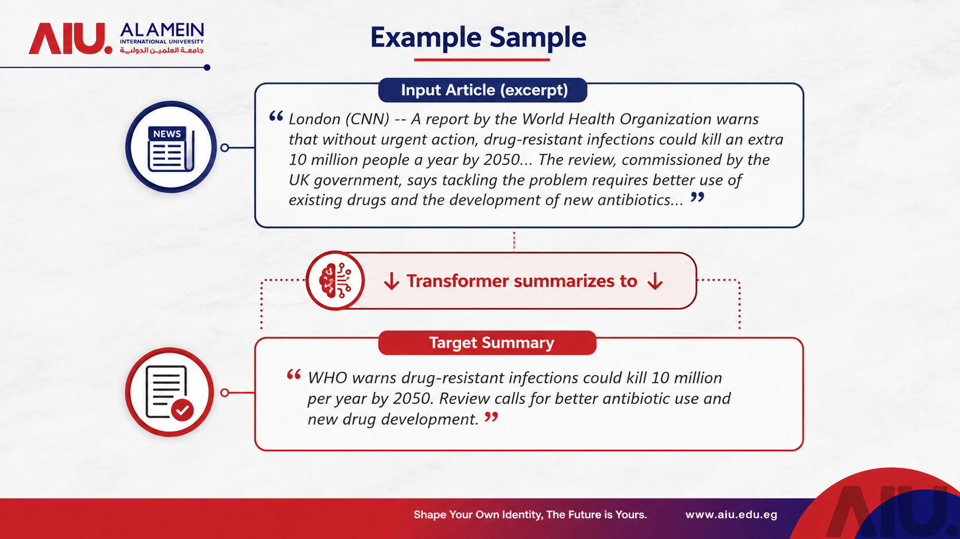

Slide 7
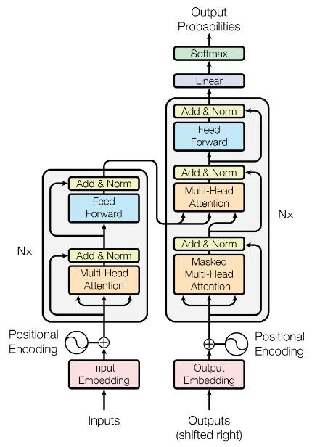
Model Design:Text Summarization
BART-large-CNN on CNN/DailyMail
Encoder-decoder Transformer | AdamW | ROUGE-based selection.
01
02
03
Architecture
Training
Generation
We operate on a global scale, bringing solutions wherever you are.
We help you drive meaningful progress within your industry.
We adapt to your unique business needs and size of operations.

Slide 8
Why BART-large-CNN?
Sequence-to-sequence summarization: read a long article and generate a concise summary.
Dataset Match
Model-Fit
Task-specific-upgrade
Honest Framing
01
02
03
04
CNN/DailyMail has article-summary pairs, so it directly fits supervised summarization.
BART combines a bidirectional encoder for understanding with an autoregressive decoder for generation.
BART-large-CNN is optimized for CNN/DailyMail summarization and gives stronger summaries than T5-small.
We fine-tune and evaluate a strong pretrained summarization Transformer, not train from scratch.

Slide 9
Architecture Flow
Correct encoder-decoder Transformer pipeline for abstractive summarization.
Article
Tokenizer
Encoder
Cross-Attention
Decoder
Beam Search
01
02
03
04
05
06
CNN/DailyMail news text
BART token IDs + attention masks
Self-attention builds article context
Decoder focuses on article information
Generates summary token by token
Selects final fluent summary

Slide 10
Training Strategy
Stable Transformer fine-tuning with Colab memory limits.
Optimizer
Learning-rate
Schedule+warmup
Early Stopping
Gradient checkpointing
Subset Strategy
01
02
03
04
05
06
AdamW handles weight decay correctly for Transformer fine-tuning.
2e-5 is conservative for a large pretrained language model.
Linear decay with warmup steps avoids unstable early updates.
Best model selected using eval_rougeL with patience of 2 evaluations.
Reduces GPU memory usage so BART-large-CNN can run safely.
2520 train / 540validation / 540 test examples for Colab stability.

Slide 11
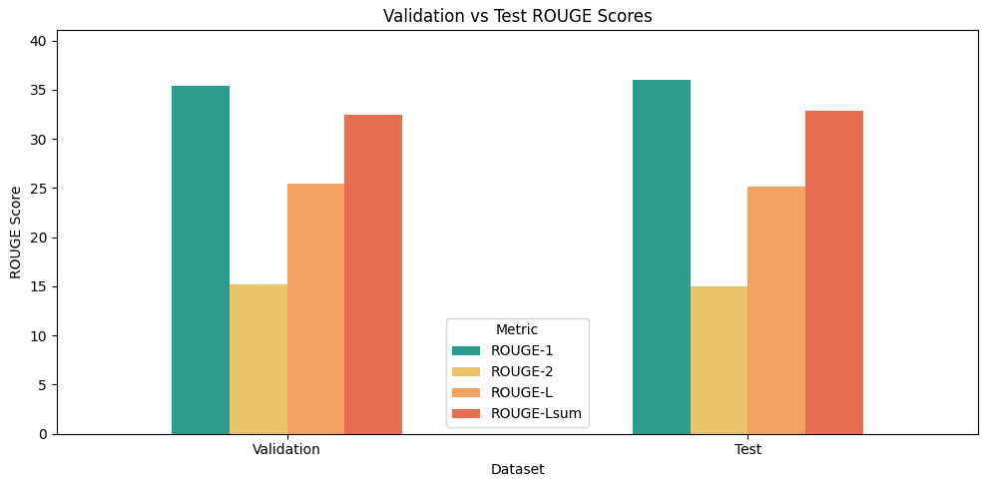
Results

Slide 12
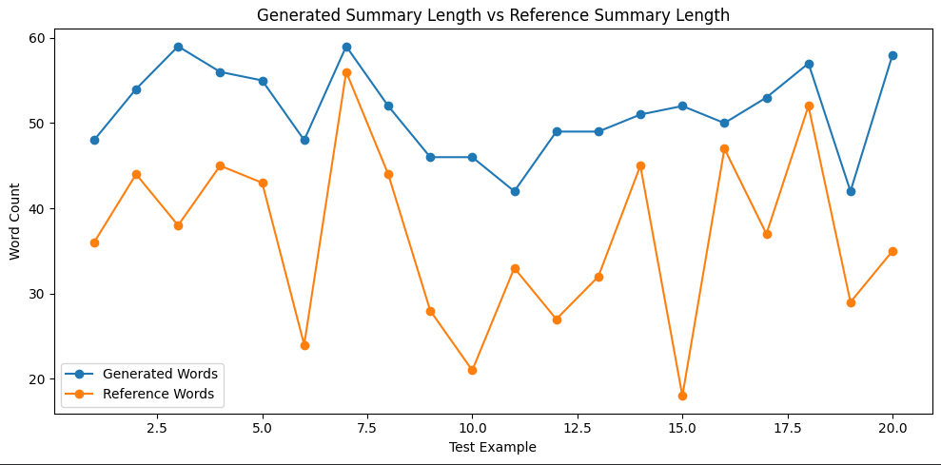
Results
This chart compares generated summary lengths with reference summary lengths. It helps show whether the model is producing summaries that are too short, too long, or close to the target style.

Slide 13
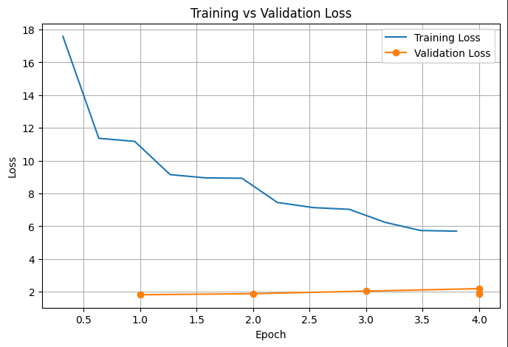
Results

Slide 14
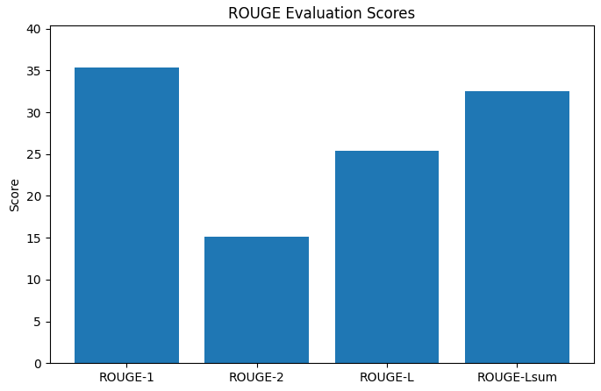
Results

Slide 15
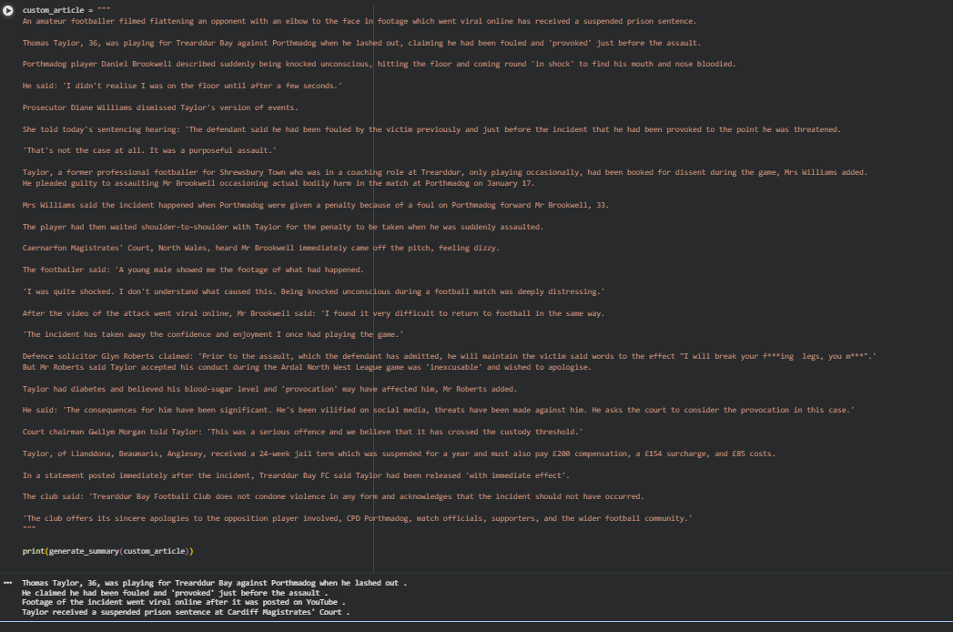
Results

Slide 16
